Slide 1
Quiz

Slide 2
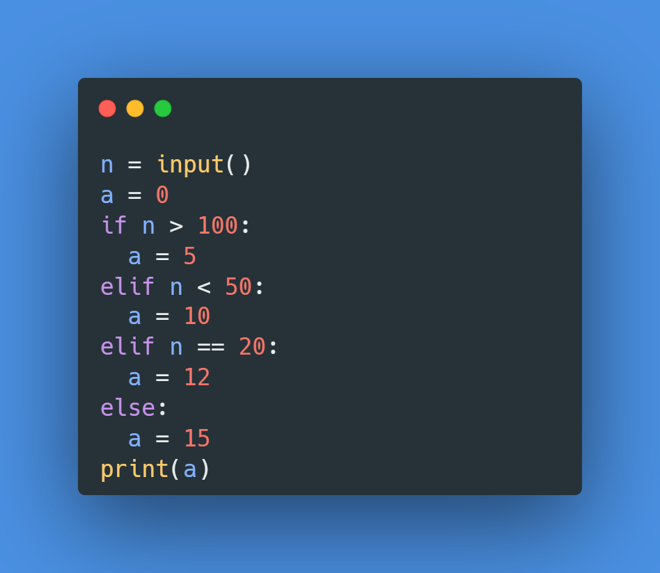
Example: What is output of this code below if user input number : 20?
Step | n | a | n>100 | n<50 | n==20 | Output
1 | 20
2 | 20 | 0
3 | 20 | 0 | 20>100:False
4 | 20 | 0 |  | 20<50:True
5 | 20 | 10 |  |  |  | 10
Notes:
5

Slide 3
What is output of this code below if user input number : 404?
step | n | a | n>100 | n<50 | n==20 | Output
1 | 404
2 | 404 | 0
3 | 404 | 0 | 404>100:True
4 | 404 | 5 |  |  |  | 4
Notes:
5

Slide 4
What is output of this code below if user input number : 50?
step | n | a | n>100 | n<50 | n==20 | Output
1 | 50
2 | 50 | 0
3 | 50 | 0 | 50>100:False
4 | 50 | 0 |  | 50<50:False
5 | 50 | 0 |  |  | 50==20:False
6 | 50 | 15 |  |  |  | 15
Notes:
15

Slide 5
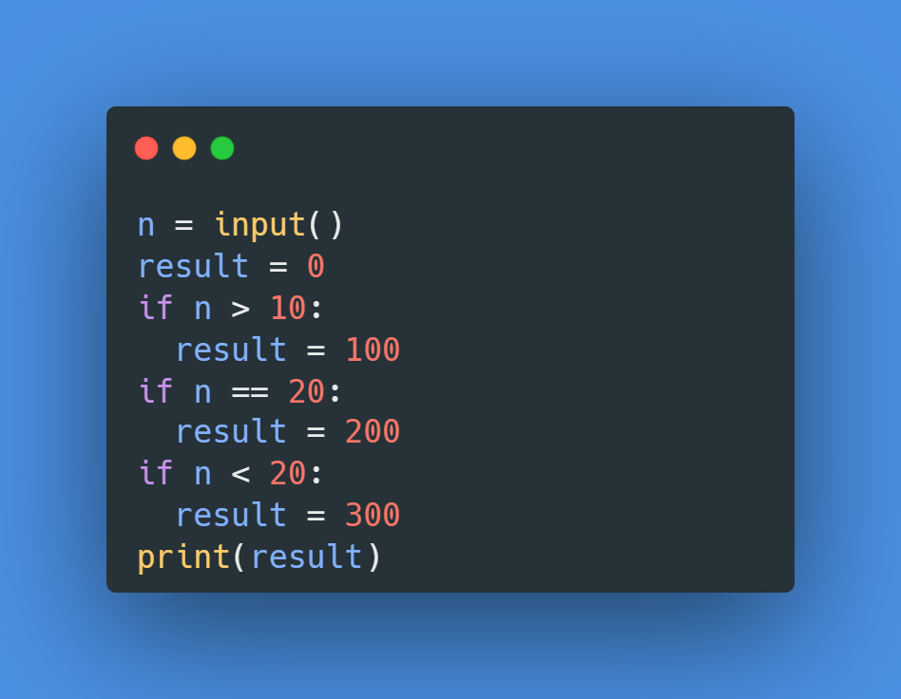
What is output of this code below if user input number : 20?
step | n | result | n>100 | n==20 | n<20 | Output
1 | 20
2 | 20 | 0 | 20>100:False
3 | 20 | 0 |  | 20==20:True
4 | 20 | 200
5 | 20 | 200 |  |  | 20<20:False
6 | 20 | 200 |  |  |  | 200
Notes:
200

Slide 6
What is output of this code below if user input number : 10?
step | n | result | n>10 | n==20 | n<20 | Output
1 | 10
2 |  | 0 | 20>10:True
3 |  | 100
4 |  | 100 |  | 20==10:False
5 |  | 100 |  |  | 10<20:False
6 |  | 100 |  |  |  | 100
Notes:
300

Slide 7
What is output of this code below if user input number : 30?
step | n | result | n>100 | n==20 | n<20 | Output
1 | 30
2 | 30 | 0 | 30>10:True
3 | 30 | 100
4 | 30 | 100 |  | 30==20:False
5 | 30 | 100 |  |  | 30<20:False
6 | 30 | 100 |  |  |  | 100
Notes:
100

Slide 8

What is output of this code below if user input number : 10?
step | n | result | n!=10 | n==50 | n>10 | Output
1 | 10
2 | 10 | 0 | 10!=10:False
3 | 10 | 0 |  | 10==50:False
4 | 10 | 0 |  |  | 10>10:False
Notes:
0

Slide 9
What is output of this code below if user input number : 12?
step | n | result | n!=10 | n==50 | n>10 | Output
1 | 12
2 | 12 | 0 | 12!=10:True
3 | 12 | 100
4 | 12 | 100 |  | 12==50:False
5 | 12 | 100 |  |  | 12>10:True
6 | 12 | 300 |  |  |  | 300
Notes:
300

Slide 10
What is output of this code below if user input number : 50?
step | n | result | n!=10 | n==50 | n>10 | Output
1 | 50
2 | 50 | 0 | 50!=10:False
3 | 50 | 0 |  | 50==50:True
4 | 50 | 200
5 | 50 | 200 |  |  | 50>10:False
6 | 50 | 200 |  |  |  | 200
Notes:
300

Slide 11
What is output of this code below if user input number : 9?
step | n | result | n!=10 | n==50 | n>10 | Output
1 | 9
2 | 9 | 0 | 9!=10:True
3 | 9 | 100
4 | 9 | 100 |  | 9==50:False
5 | 9 | 100 |  |  | 9>10:False
6 | 9 | 100 |  |  |  | 100
Notes:
100

Slide 12
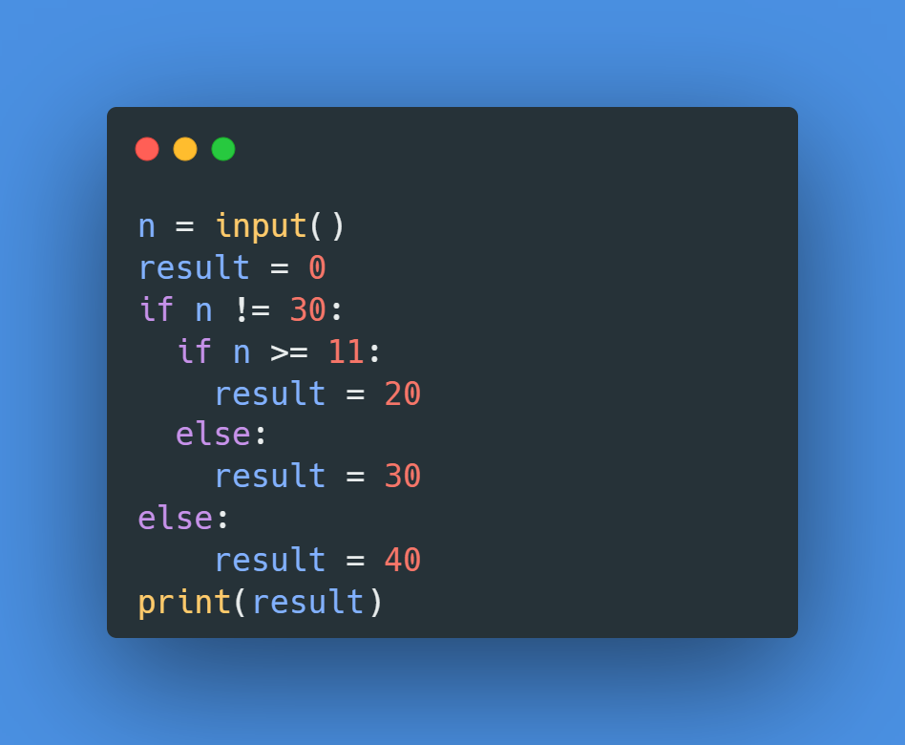
What is output of this code below if user input number : 13?
step | n | result | n!=30 | n>=11 | Output
1 | 13
2 | 13 | 0 | 13!=10:True
3 | 13 | 0 |  | 13>=11:True
4 | 13 | 20 |  |  | 20
Notes:
20

Slide 13
What is output of this code below if user input number : 30?
step | n | result | n!=30 | n>=11 | Output
1 | 30
2 | 30 | 0 | 30!=30:False
3 | 30 | 0 |  | 30>=11:True
4 | 30 | 20 |  |  | 20
Notes:
40

Slide 14
What is output of this code below if user input number : 7?
step | n | result | n!=30 | n>=11 | Output
1 | 7
2 | 7 | 0 | 7!=30:True
3 | 7 | 0 |  | 7>=11:True
4 | 7 | 30 |  |  | 30
Notes:
30

Slide 15
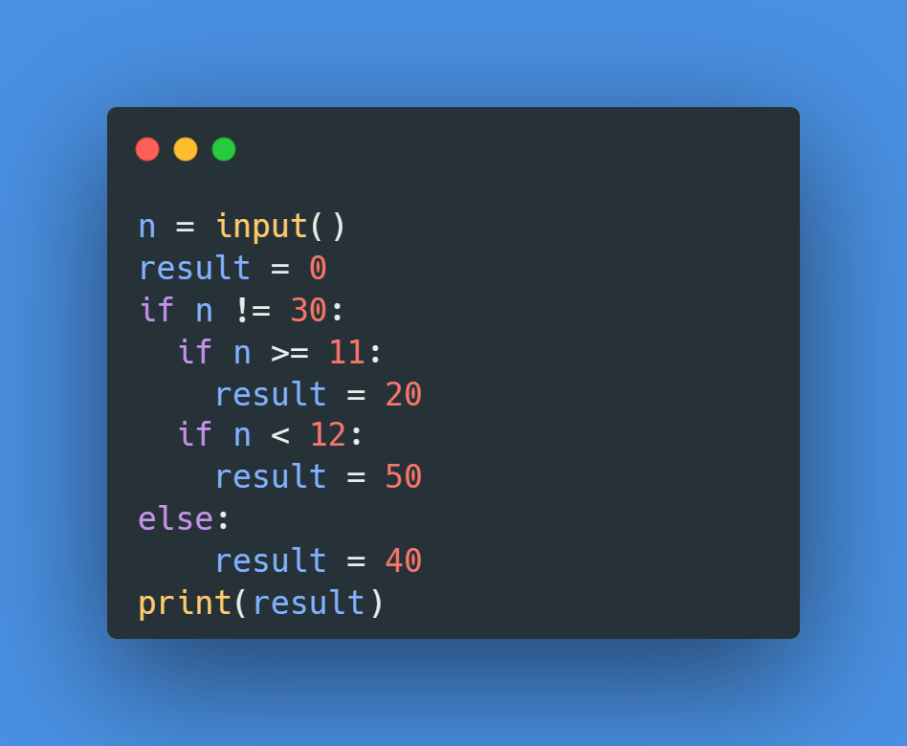
What is output of this code below if user input number : 11?
step | n | result | n!=30 | n>=11 | n<12 | Output
1 | 11
2 | 11 | 0 | 11!=30:True
3 | 11 | 0 |  | 11>=11:True
4 | 11 | 20
5 | 11 | 20 |  |  | 11<12:True
6 | 11 | 50 |  |  |  | 50
Notes:
50

Slide 16
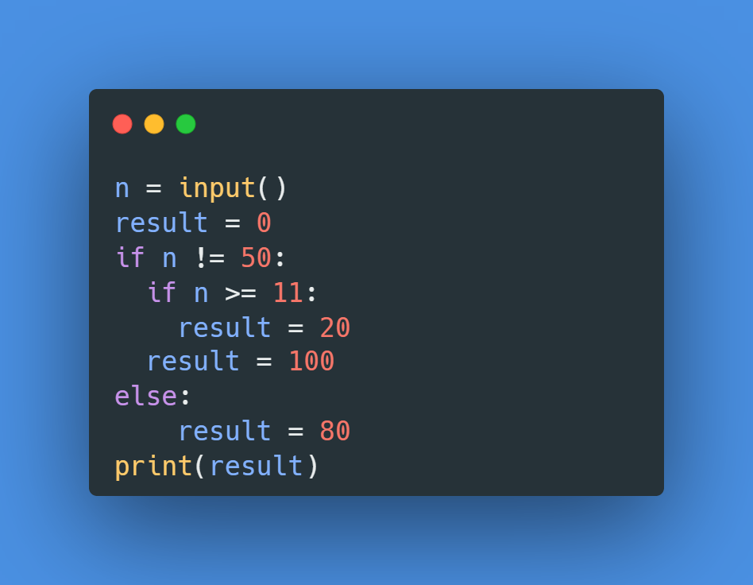
What is output of this code below if user input number : 50?
step | n | result | n!=50 | n>=11 | Output
1 | 50
2 | 50 | 0 | 50!=50:False
3 | 50 | 0 |  | 50>=11:True
4 | 50 | 20 |  |  | 20
Notes:
80

Slide 17
What is output of this code below if user input number : 100?
step | n | result | n!=50 | n>=11 | Output
1 | 100
2 | 100 | 0 | 100!=50:True
3 | 100 | 0 |  | 100>=11:True
4 | 100 | 100 |  |  | 100
Notes:
100

Slide 18
What is output of this code below if user input number : 10?
step | n | result | n!=50 | n>=11 | Output
1 | 10
2 | 10 | 0 | 10!=50:True
3 | 10 | 0 |  | 10>=11:False
4 | 10 | 80 |  |  | 80
Notes:
100

Slide 19
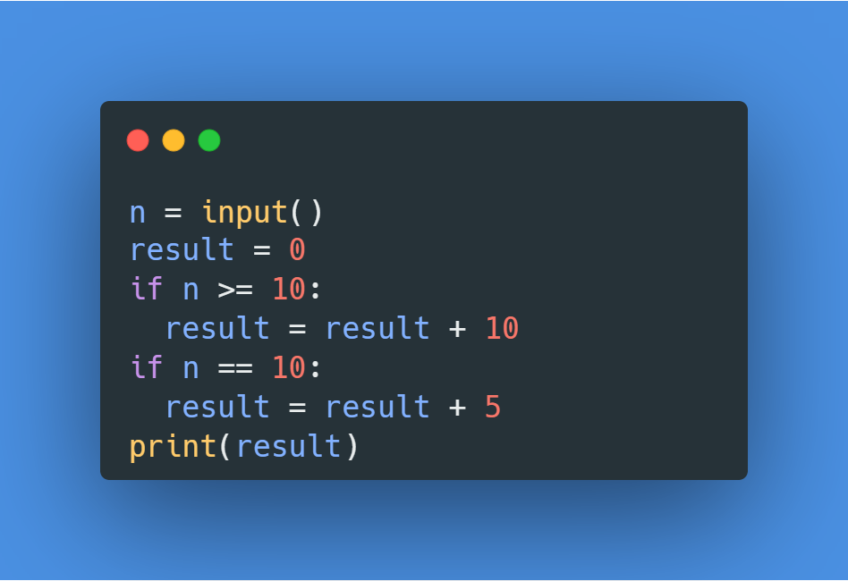
What is output of this code below if user input number : 10?
step | n | result | n>=10 | n==10 | Output
1 | 10
2 | 10 | 0 | 10>=10:True
3 | 10 | result= result+10 result=10
4 | 10 | 10 |  | 10==10:True
5 | 10 | result=result+5 result=15
6 | 10 | 15 |  |  | 15
Notes:
15

Slide 20
What is output of this code below if user input number : 5?
step | n | result | n>=10 | n==10 | Output
1 | 5
2 | 5 | 0 | 5>=10:False
3 | 5 | 0 |  | 5==10:False
Notes:
0

Slide 21
What is output of this code below if user input number : 15?
step | n | result | n>=10 | n==10 | Output
1 | 15
2 | 15 | 0 | 15>=10:True
3 | 15 | result= result+10 result=10
4 | 15 | 10 |  | 15==10:False
5 | 15 | 10
6 | 15 | 10 |  |  | 10
Notes:
10

Slide 22
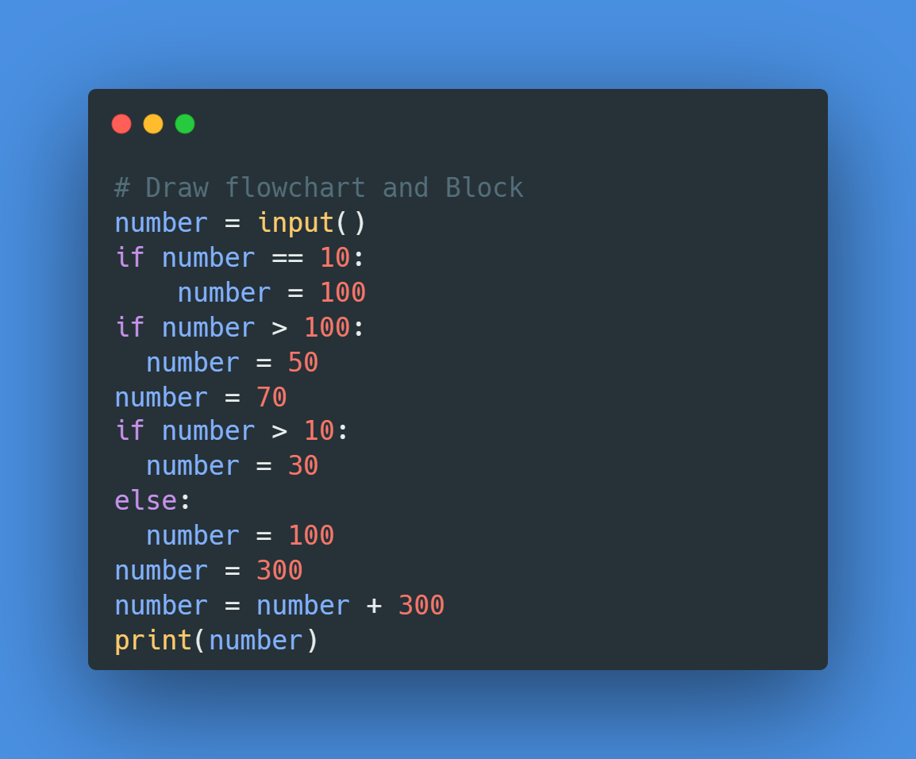
What is output of this code below if user input number : 10?
step | number | number==10 | number>100 | Number>10 | Output
1 | 10
2 | 10 | 10==10:True
3 | 100
4 | 100 |  | 100>100:False
5 | 70 |  |  | 70>10:True
6 | 30
7 | 300
8 | 600 |  |  |  | 600
Notes:
300

Slide 23
What is output of this code below if user input number : 110?
step | number | number==10 | number>100 | Number>10 | Output
1 | 110
2 | 110 | 110==10:False
3 | 110 |  | 110>100:True
4 | 50
5 | 50 |  |  | 50>10:True
6 | 30
7 | 300
8 | 600 |  |  |  | 600
Notes:
300

